Slide 1
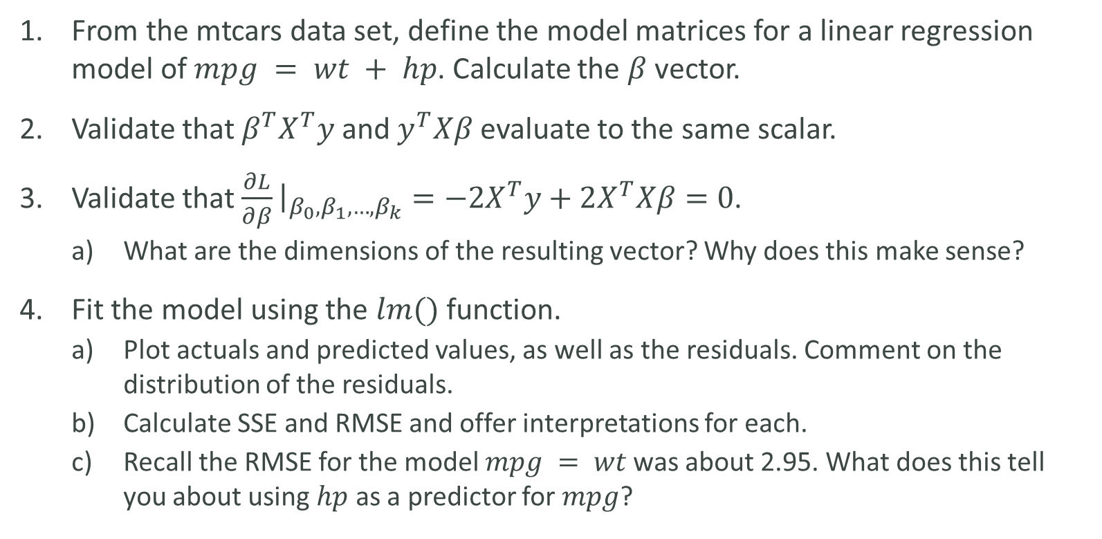
LAB
From the mtcars data set, define the model matrices for a linear regression model of $mpg = wt + hp$. Calculate the $β$ vector.
Validate that $β^{T}X^{T}y$ and $y^{T}Xβ$ evaluate to the same scalar.
Validate that $\frac{∂L}{∂β}{\left.​\right|}_{β_{0}, β_{1},…,β_{k}}=−2X^{T}y+2X^{T}Xβ=0$.
What are the dimensions of the resulting vector? Why does this make sense?
Fit the model using the $lm()$ function.
Plot actuals and predicted values, as well as the residuals. Comment on the distribution of the residuals.
Calculate SSE and RMSE and offer interpretations for each.
Recall the RMSE for the model $mpg = wt$was about 2.95. What does this tell you about using $hp$ as a predictor for $mpg$?

